Slide 1
Buildings update St Paul’s PCC sub-Committee Next Steps Team

Slide 2
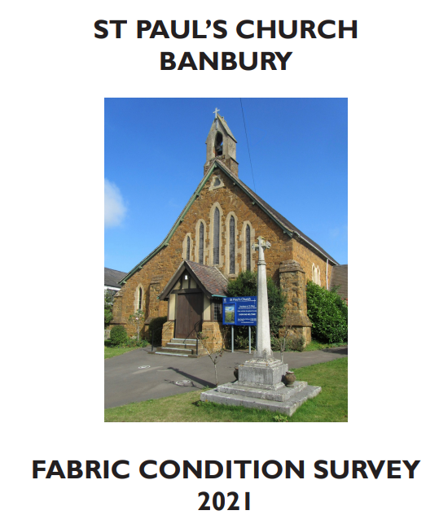
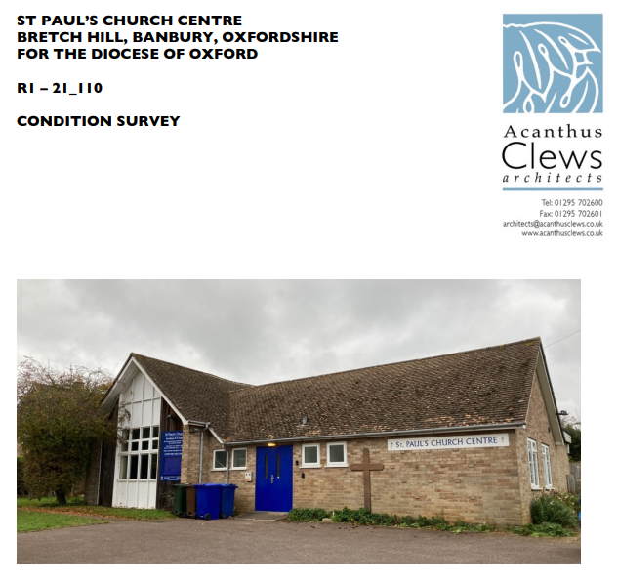
WR Quinquennial Inspection - Nov 2021
PA Condition Report - Feb 2022

Slide 3
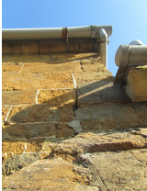
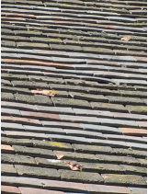
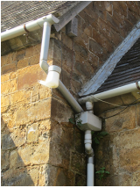
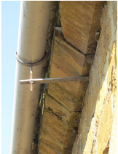
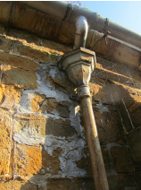
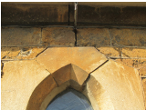
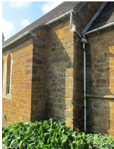
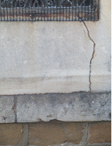
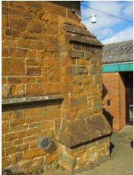
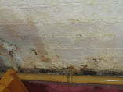
WR

Slide 4
Warwick Road works so far: 1853 - Office & Hall additions
Replaced 3 heaters, safety glass in door, cleared gutters, electrical safety, LED light bulbs, Audio/visual upgrade, Hall asbestos removed, some flood damage
Inspection reports of structural issues (including high level), drainage and stained glass
Appointment of Church Architect – Caroline Edwards
Warwick Road works to do:
Completely new drainage system underground (by Oct’23)
Roof repairs and resizing of guttering / rainwater goods
North wall structural repairs – roof spread, retaining wall plate and rafters
External: damp, dressed Hornton stone & bellcote repairs
Internal: lighting, flooring, A/V, plaster and decorations
A new Hall with facilities – following options appraisal

Slide 5
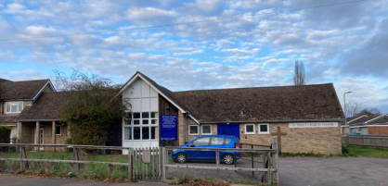
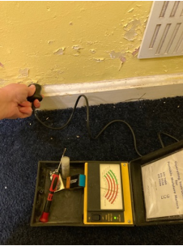
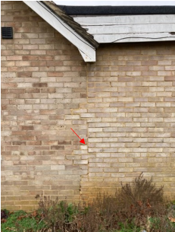
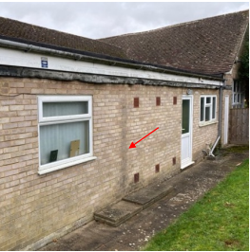
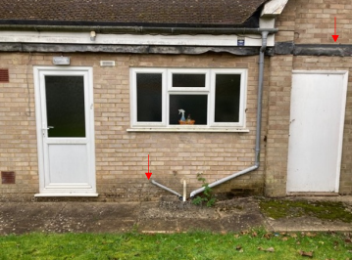
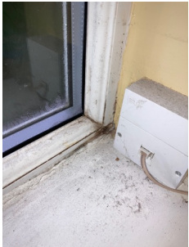
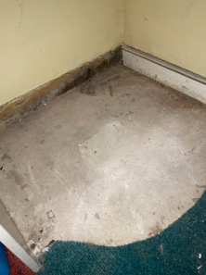
Prescott Avenue

Slide 6
Prescott Avenue works so far:
1960’s build with flat roof 80’s extension
Heating, roof structure, insulation, safety glass and decoration, with ongoing gardening and fencing
Prescott Avenue works to do:
Drains – repair and maintain foul and surface water systems
Structural – monitoring of cracks to assess movement due to extension and include racking of roof structure
Assess and repair causes of damp, including guttering and bargeboard / cladding
Internal: repairs, decoration, glazing, Fire Safety
External: replace paving, damp proof membrane to ext’n

Slide 7
Brief to Caroline Edwards (Church Architect):
Identify a budget cost for the semi-urgent works – structural and drains.
Explore possible re-ordering and phased extensions at WR at a conceptual level with budget costs.
Explore options at PA from extension / renovation through to re-building at a conceptual level with budget costs.

Slide 8
Summary:
Our buildings are in a poor condition – age and decay.
There are structural concerns with the roof and North aisle wall at WR, and the drains (both storm and foul) have completely failed.
There are further structural concerns at PA.
The church architect has been commissioned to scope the works and we await more news on costs and options.
The reality is that this will constrain what we are able to afford in terms of a replacement Hall at WR, but allow for improved provision of the space in our current buildings.
Much prayer and sacrificial giving is needed. But, the Lord has been amazingly generous and faithful to us thus far…

